Slide 1
Smart Procurement & Vendor Management System
By:- Aryan Shastri , Batch 11

Slide 2
Problem Statement
In many organizations, procurement activities like requesting items, approving purchases, and managing vendors are still handled manually through emails, spreadsheets, or paper processes.
This leads to delays, lack of transparency, and difficulty in tracking the status of requests and approvals.
There is also no centralized system to manage vendor information or maintain proper audit records. As a result, procurement becomes inefficient, error-prone, and hard to monitor.

Slide 3
Solution
To address the challenges of manual procurement, I developed a Smart Procurement & Vendor Management System that automates and streamlines the entire procurement lifecycle.
The system digitalizes requisition creation, approvals, purchase orders, and vendor management, ensuring transparency, control, and efficiency in procurement operations.
This solution provides several key features that enable organizations to manage procurement operations effectively:
Digital Procurement Workflow
Employees can create requisitions and track approvals digitally . This replaces slow manual processes with an automated workflow.
Centralized Vendor & Order Management
All vendor and purchase order data is maintained in one system . This ensures accurate tracking and better supplier coordination.
Secure Role-Based Access
JWT authentication and roles control what each user can do. This protects procurement operations from unauthorized access.
Approval & Audit Transparency
Approvals and actions are recorded with audit logs. This improves accountability and process visibility.
Automated Reporting
Reports can be generated in PDF and Excel formats. This helps monitor procurement and vendor performance.
Scalable Backend Architecture
The system uses layered Spring Boot REST architecture. This makes it maintainable and easy to expand in future.

Slide 4
Technology Stack
Backend: Spring Boot
Security: Spring Security + JWT
Database: MySQL
ORM: JPA / Hibernate
Reporting: JasperReports

Slide 5
Project Architecture
Client
↓
Controller Layer (REST APIs)
↓
Service Layer (Business Logic)
↓
Repository Layer (JPA)
↓
Entity Layer (JPA Entities)
↓
MySQL Database

Slide 6
Database Design
User & Role
Manages system users and access permissions. Roles like Admin, Manager, and Employee control what actions users can perform.
Vendor
Stores supplier information such as name, contact, status, documents, and ratings used for vendor evaluation.
Requisition & Items
Represents internal purchase requests created by employees. Each requisition contains multiple requested items.
Purchase Order & Items
Generated from approved requisitions and sent to vendors. Contains ordered products, pricing, and order status.
Approval
Tracks approval or rejection of requisitions and purchase orders with approver details and timestamps.

Slide 7
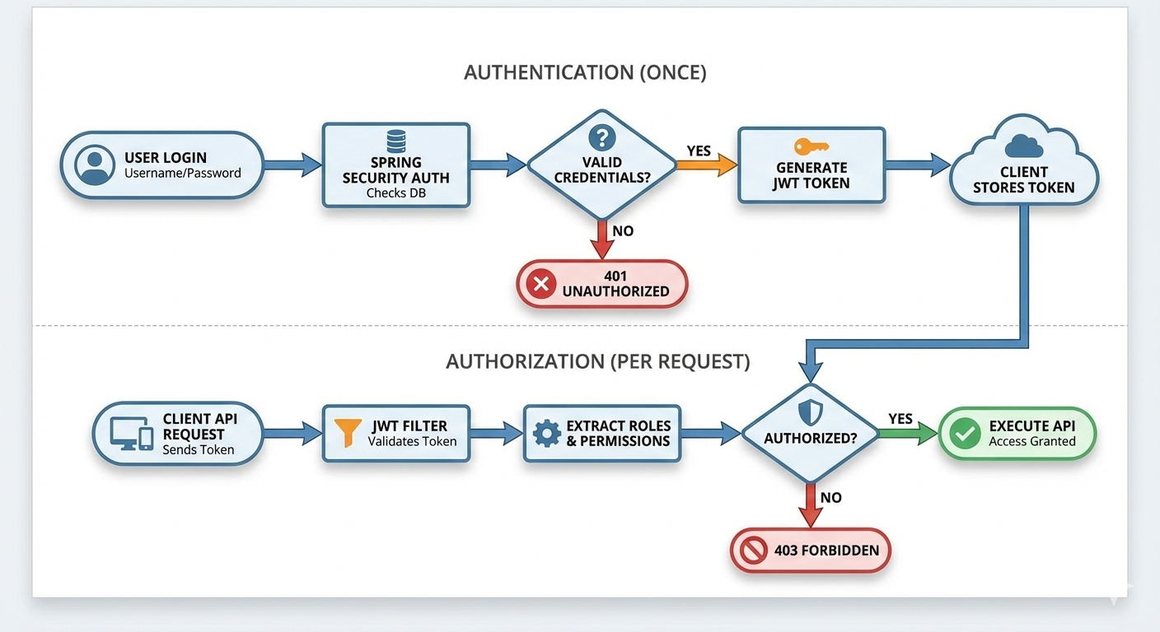
Authentication Flow

Slide 8
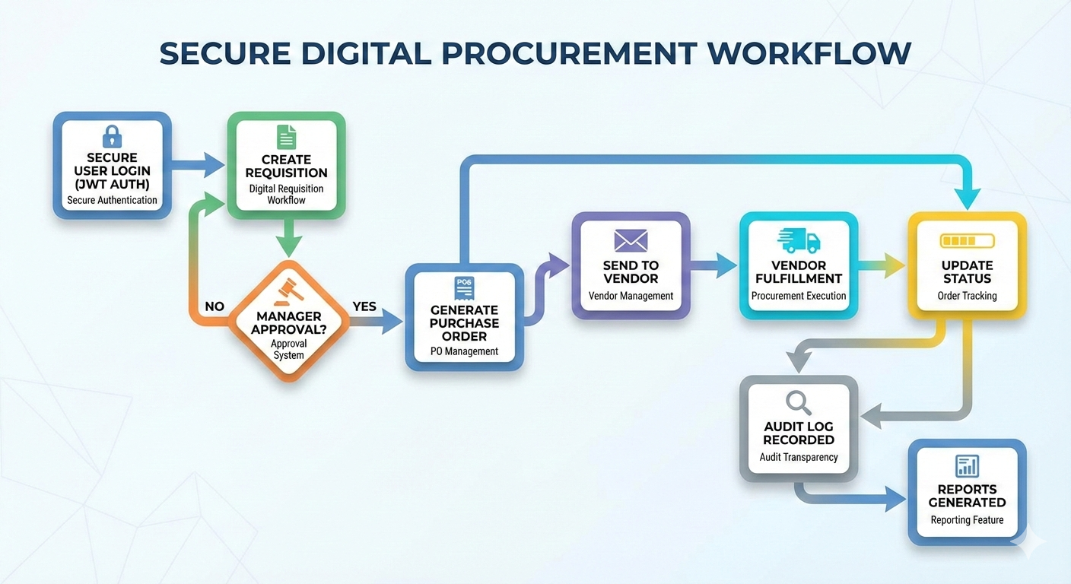
Complete Workflow

Slide 9
Role Responsibility
Different roles in the system ensure controlled procurement operations.
Users create requisitions, procurement managers review and approve them, and administrators manage vendors, users, and system.
Role-based permissions ensure users can only perform actions relevant to their responsibilities, improving security and accountability.

Slide 10
Requisition Lifecycle
A requisition moves through defined stages starting from creation by a user.
It then enters approval status where managers review it.
Once approved, it is converted into a purchase order.
If rejected, it is closed with remarks.
This lifecycle ensures structured tracking of purchase requests and prevents unauthorized procurement.

Slide 11
API Structure
The system exposes RESTful APIs organized by modules such as authentication, procurement, vendor, and reporting.
Each module contains endpoints for create, read, update, and delete operations.
APIs follow standard HTTP methods and JSON responses, enabling easy integration with frontend applications or external systems.

Slide 12
Security Implementation
Security is implemented using Spring Security with JWT authentication and role-based authorization.
Passwords are encrypted using BCrypt hashing.
Protected endpoints require valid tokens, and permissions are checked before executing actions.
This ensures secure access control and protects procurement data from unauthorized use.

Slide 13
Error Handling
The system includes centralized exception handling using a global exception handler.
All errors such as resource not found, unauthorized access, or business rule violations are captured and returned as structured API responses.
This provides consistent error messages and improves debugging and user experience.

Slide 14
Key Features
The system provides end-to-end procurement automation including requisition creation, approval workflow, vendor management, purchase order tracking, reporting, and audit logging.
Role-based security and JWT authentication ensure safe access, while layered architecture supports scalability and maintainability.

Slide 15
Limitations
Currently, the system uses basic reporting data and does not include advanced analytics or real-time vendor integration.
Multi-level approval rules and notification features are limited.
The frontend interface is also minimal, focusing mainly on backend functionality and API operations.

Slide 16
Future Enhancements
Future improvements include advanced dashboards, email and notification alerts, real-time vendor integration, multi-stage approval workflows, and analytics reporting.
Cloud deployment and microservice architecture can further improve scalability and enterprise readiness.

Slide 17
Conclusion
The Procurement & Vendor Management System successfully digitizes procurement processes, improving efficiency, transparency, and control.
It demonstrates secure authentication, structured workflow management, and scalable architecture using modern Spring Boot technologies.
The system can serve as a foundation for enterprise procurement automation.

